Slide 1
Safe regression test selection for Modelica
By Erik Hedblom and Kasper Rundquist

Slide 2
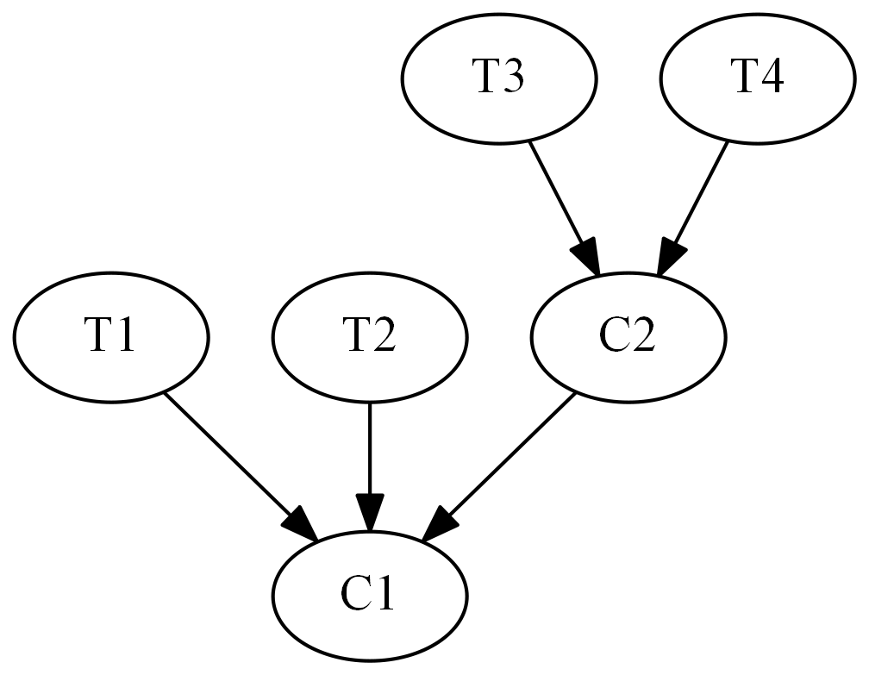
Safe test selection
Notes:
Safe: garantera att alla tester som skulle kunna misslyckas faktiskt körs
Naiv metod: kör alla tester
Lång tid att köra alla tester
Inverterade beroenden

Slide 3
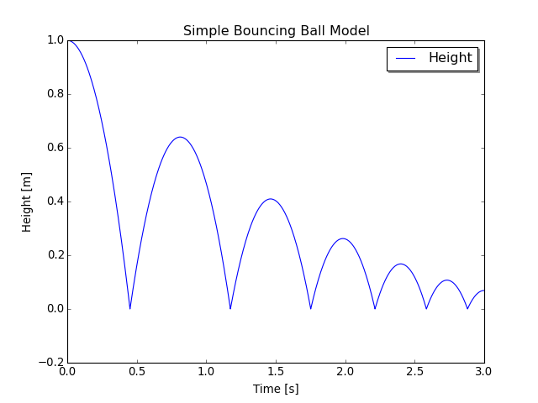
Modelica Bouncing Ball example
model BouncingBall //The 'classic' bouncing ball model
parameter Real e = 0.8; //Elasticity coefficient
parameter Real g = 9.81; //Acceleration due to gravity
Height h(start=1); //Height of the ball
Velocity v(start=0); //Velocity of the ball
equation
der(h) = v; //Newtons second law
der(v) = -g;
when h <= 0 then
reinit(v, -e*pre(v)); //Set velocity after bounce
end when;
end BouncingBall;

Slide 4
Source tree name lookup limitations
package P
model M1
replaceable package P0 = P1;
function f = P0.f;
end M1;
model M2
M1 m(replaceable package P0 = P2);
Real y = m.f (10);
end M2;
end P;

Slide 5
OPTIMICA Compiler Toolkit and JModelica.org

Slide 6
Model Testing Toolkit
Model Testing Toolkit
GUI
OPTIMICA Compiler Toolkit

Slide 7
Dependency rules
A class depends on all classes referenced by resolvable accesses within it, not including accesses within paths.
A class depends on its enclosing class.
A class depends on all classes referenced by access paths within it. A unresolvable access can still contain resolvable accesses within its path.

Slide 8
Dependency rules
A class depends on all classes enclosed by an accessed class. This does not include access within paths but if an access is not resolvable, the last resolvable access in the path will be used instead.
Exception to Rule 4: Rule 4 is not applicable to import statements.

Slide 9
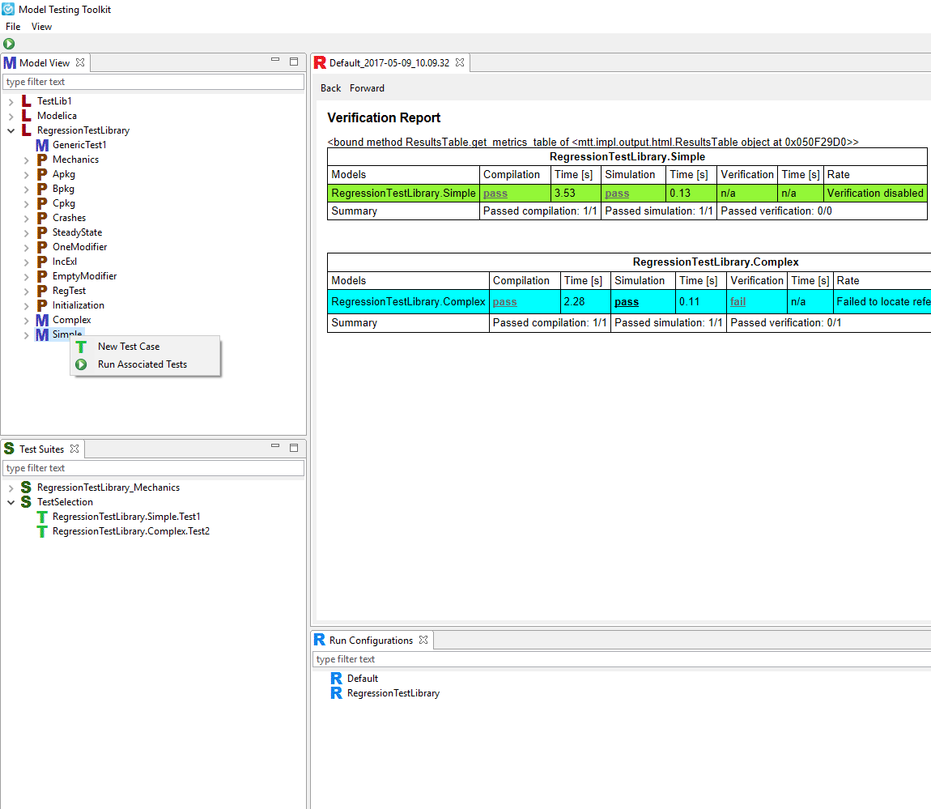
Added functionality in GUI
Notes:
Färdiga med beroendeanalysen
Lagt till funktionalitet i GUI
Modellerare testar
Mätt tiden för att köra MSL tester

Slide 10
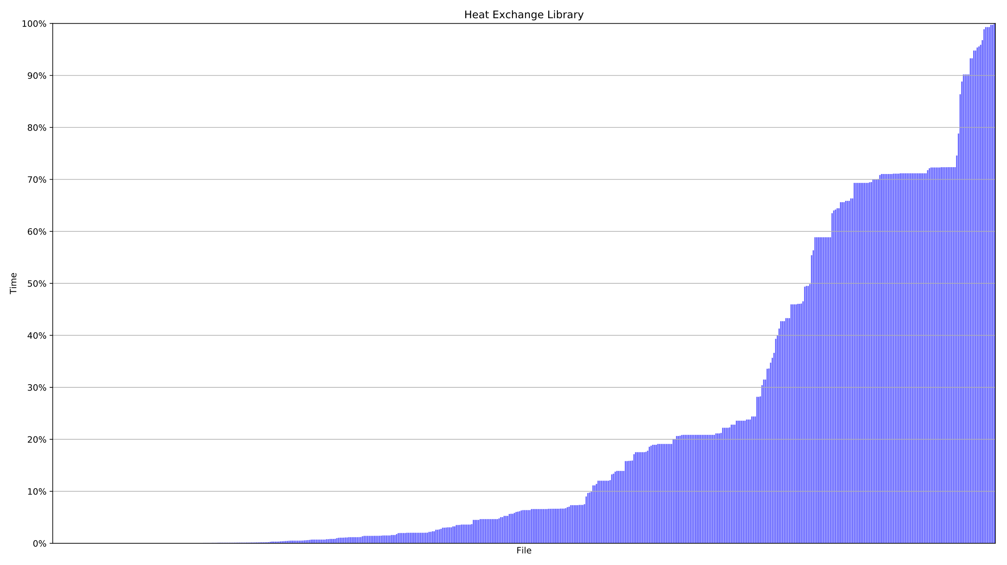
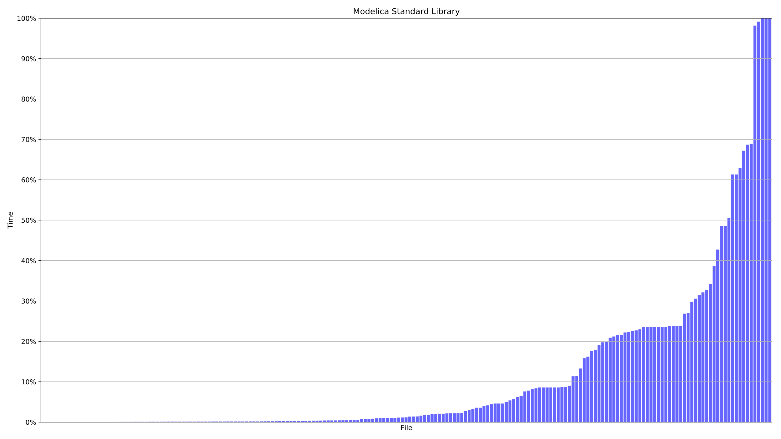
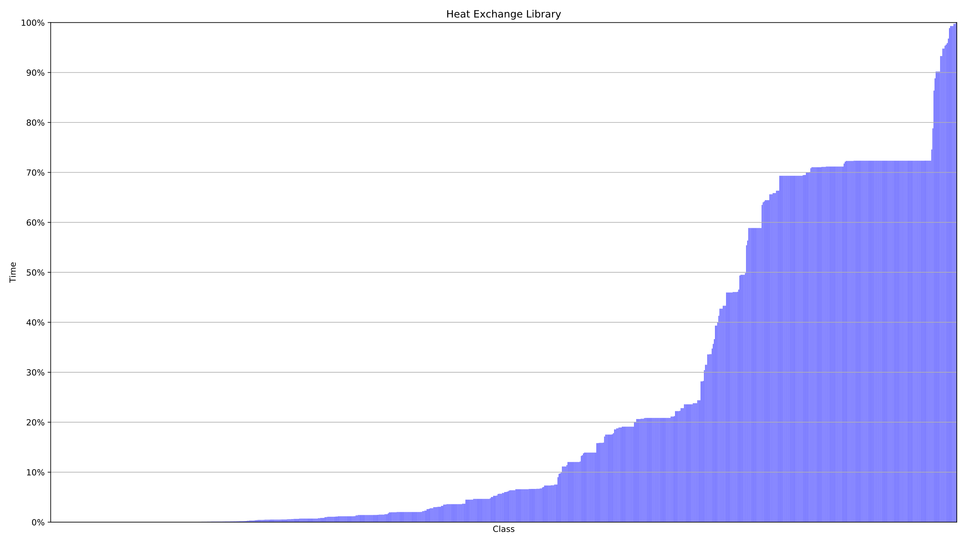
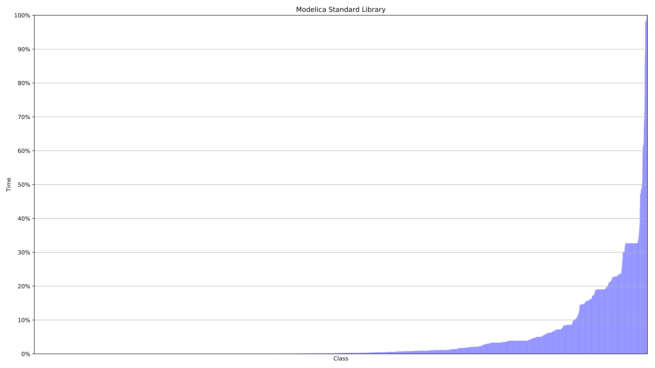
Resultat filer och klasser

Slide 11
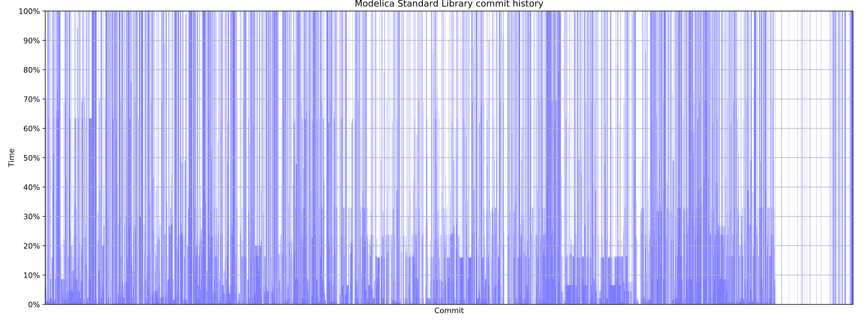
Resultat historiken

Slide 12
Breakdown of the results
 | Units | Complete testsuite execution time | Dependency analysis exectution time | Average time savings
HXL | 552 files | 3h 1m 51s | 6.7s | 68%
 | 819 classes |  |  | 67%
MSL | 197 files | 2h 26m 36s | 18.8s | 88%
 | 5917 classes
 |  |  |  | 93%
 | 4341 commits
 |  |  |  | 56%

Slide 13
Validation/Future work
Run testselection in paralell with complete testsuite
Mutation testing
Move implementation to instance tree?

